Slide 1
Project CEOS
Comprehensive Equity at Ohio State
leading to excellence
ceos.osu.edu

Slide 2
Outline
Overview of social science literature (Herbers)
The climate for women faculty at Ohio State (Carpenter-Hubin)

Slide 3
The problem: a persistent loss of women from scientific fields throughout phases of career development.
What causes these losses of talent?
Why is it important?
What can be done to prevent such losses?

Slide 4
The psychology of gender: general issues
Virginia Valian describes how gender schemas impede women’s progress
Women are underestimated when in leadership positions
Women’s credentials are implicitly devalued
Women face unconscious bias in competitions for fellowships, journal space, recognition by prestigious societies
Microinequities repeated over time create major inequities

Slide 5
Case study: linguistic analysis of letters of recommendation for faculty positions in a research university
Linguistic Category | Examples of terms
Communal Adjectives | Affectionate, helpful, kind, sympathetic, sensitive, nurturing, agreeable, caring
Agentic | Assertive, confident, aggressive, ambitious, dominant, forceful, intellectual
Social-communal orientation | Husband, wife, kids, babies, brothers, children, family
Grindstone | Hardworking, conscientious, dependable, meticulous
Physical –body | Arms, breast, eyes, face, hips, hair, muscle, nails, pregnancy, mouth

Slide 6
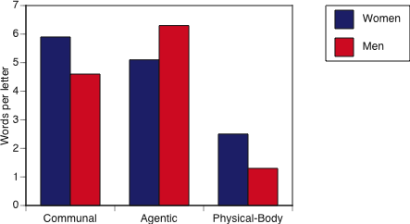
Case study: linguistic analysis of letters of recommendation for faculty positions in a research university
All P<0.01; results of MANCOVA controlling for years in graduate school, N of publications, honors, N of postdoc years, N of courses taught, and type of position
Source: Rice University ADVANCE program

Slide 7
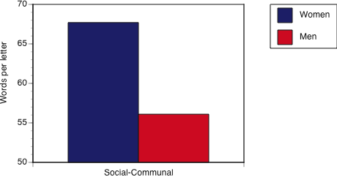
Case study: linguistic analysis of letters of recommendation for faculty positions in a research university
P<0.01; results of MANCOVA controlling for years in graduate school, N of publications, honors, N of postdoc years, N of courses taught, and type of position
Source: Rice University ADVANCE program

Slide 8
Case study: Publication in a scientific journal
In 2000, Behavioral Ecology instituted double-blind review.
Analysis of first-authorship by gender from 1995-2000 compared to 2002-2007 (2001 omitted as a transition year)
Comparison to two journals with very similar coverage and impact factor
Budden AE et a. 2008. Double-blind review favours increased representation of female authors. Trends in Ecology and Evolution 23:4-6

Slide 9
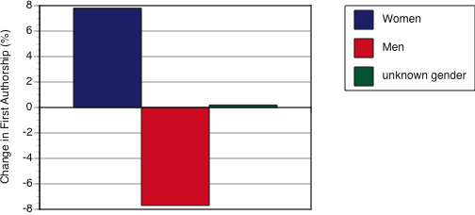
Changes in first authorship for Behavioral Ecology
No such shifts occurred in Animal Behaviour or Behavioral Ecology and Sociobiology
Publications 1995-2000 versus 2002-2007

Slide 10
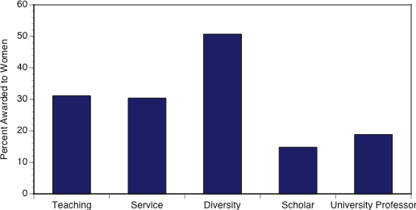
And here at Ohio State University
University awards from 2001-2009

Slide 11
University awards from 2001-2009

Slide 12
The psychology of gender: general issues
Stereotype threat can impair girls’ and women’s performance in STEM

Slide 13
Stereotype threat can impair girls’ and women’s performance

Slide 14
Stereotype threat can impair girls’ and women’s performance

Slide 15
Stereotype threat impairs performance in numerous contexts:
Women and girls in mathematics and science
African-Americans on IQ tests
White Americans on tests of physical ability
Elderly on tests of recall and memory

Slide 16
The psychology of gender: general issues
Women and Negotiation
Babcock and Laschever describe the psychology of negotiation, demonstrate that men and women have differing attitudes and practices of negotiating, and show how this leads to gender disparity in salary, career advancement, and job satisfaction.
Example: A man at age 22 negotiates a $5000 raise above what is offered, while a women accepts the first offer. By retirement age of 65, that head start alone (compounded at 3% per year) yields an additional $784,192

Slide 17
Women and Negotiation
Men initiate negotiations 4x as often as women
Men compare negotiating to a wrestling match, while women compare it to a trip to the dentist
Women are willing to pay an additional $1353 for a car in order to avoid negotiation
Women who do negotiate wind up with 30% less on average than men who negotiate

Slide 18
The psychology of gender: general issues
Fairness
Psychologists have defined three dimensions to how people perceive fairness:
1) Outcomes fairness: do all individuals have access to the same information? Are assessments based upon clearly-defined expectations?

Slide 19
Fairness
Psychologists have defined three dimensions to how people perceive fairness:
1) Outcomes fairness: do all individuals have access to the same information? Are assessments based upon clearly-defined expectations?
2) Procedural fairness: are processes clear to all individuals? Are they given constructive feedback? Are the rules applied to all individuals equally?

Slide 20
Fairness
Psychologists have defined three dimensions to how people perceive fairness:
1) Outcomes fairness: do all individuals have access to the same information? Are assessments based upon clearly-defined expectations?
2) Procedural fairness: are processes clear to all individuals? Are they given constructive feedback? Are the rules applied to all individuals equally?
3) Interactional fairness: are individuals given access to the same social networks, and are they treated with respect, propriety, integrity, and impartiality?

Slide 21
Psychological research has demonstrated that outcomes fairness is the least important dimension to individuals.
Example: classroom teaching
Outcomes fairness: clear syllabus, accurate assessments, grading based upon performance
Procedural fairness: workload, test coverage, responsiveness to students
Interactional fairness: impartiality, respect, integrity, propriety of behavior

Slide 22
Psychological research has demonstrated that outcomes fairness is the least important dimension to individuals.
Example: classroom teaching
Outcomes fairness: clear syllabus, accurate assessments, grading based upon performance Rank = 3
Procedural fairness: workload, test coverage, responsiveness to students Rank = 2
Interactional fairness: impartiality, respect, integrity, propriety of behavior Rank = 1

Slide 23
Example: climate data from a research university on the east coast
t(1,69) = 2.89, p < 0.01
Example: I feel like I “fit” in my department.

Slide 24
t(1,76) = 3.10, p < 0.01
Example: Communication is good among the people in my department.

Slide 25
A look at the pipeline:
Undergraduate students
Graduate students
Postdocs
Faculty

Slide 26
The STEM pipeline
why undergraduates switch from STEM majors:
Men | Women
1. Loss of interest in STEM | 1. Other majors offer better education
2.Curriculum Overload | 2. Loss of interest in STEM
3. Poor teaching in STEM | 3. Rejection of STEM lifestyle
4. Career path too hard | 4. Poor teaching in STEM
5. Other majors offer better education | 5. Poor advising

Slide 27
The STEM pipeline
Graduate students
At entry (University of California campuses), 45% of men and 39% of women intend to become professors at a research university
Within 2 years, only 36% and 29% still maintain that career aspiration. In the sciences, only 21% of the women wish to become research faculty by the time they graduate
Those who changed their minds are aiming primarily for careers in business or government rather than other academic institutions

Slide 28
Why graduate students leave the research track
Women | Men
1. Other life interests | 1. Negative student experiences
2. Issues related to children | 2. Other life interests
3. Negative student experiences | 3. Professional activity too time consuming
4. Professional activity too time consuming | 4. Feelings of isolation/alienation as a student
5. Geographic-location issues | 5. Geographic location issues
6. Feelings of isolation/alienation as a student | 6. Marriage or partner issues
Mason, MA and M Goulden. 2009. Why graduate students reject the fast track. Academe January-February issue.

Slide 29
The STEM pipeline
What about postdocs?
A relatively unstudied population, especially with regard to gender differences
This group is at high risk for leaving research careers, with proportionately more women leaving research than men
Women postdocs report lower job satisfaction and confidence in their abilities to have successful research careers than men

Slide 30
Postdocs at NIH on factors affecting career decisions:
 | % of women | % of men
Plans to have children | 21% | 7%
Spending time with family members other than kids | 40% | 25%
Day care provided by spouse or relative | 25% | 72%
I will make career concessions for my spouse | 65% | 51%
I expect my spouse to make concessions for my career | 49% | 59%
Martinez ED et al. 2007. Falling off the academic bandwagon. EMBO Reports 8:977-981

Slide 31
Stay tuned
The National Postdoctoral Association (NPA) has received an ADVANCE grant to
Conduct a review of institutional efforts to support postdoc work-life balance
Organize a national summit on Gender and the Postdoctorate
Develop a resource compendium for research institutions and hold workshops on recommended practices

Slide 32
The STEM pipeline
Faculty life for scientists and engineers
Women and men STEM faculty have very different family situations:
 | Men | Women
Married with children | 70% | 44%
Married without children | 15% | 19%
Single without children | 11% | 26%
Single with children | 4% | 19%

Slide 33
Married STEM faculty have very different home situations:
 | Men | Women
Spouse works full-time | 45% | 89%
Spouse works part-time | 20% | 5%
Spouse not employed | 35% | 6%
Spouse is also a scientist | 48% | 78%

Slide 34
And there are more issues to be considered:
Bias avoidance: individuals do not take advantage of policies if they perceive negative consequences (e.g. time on the tenure clock)
Teaching environments differ for male and female professors (student behavior and evaluations)
Workload distribution (types of courses, committee work)

Slide 35
Why is diversity an important issue for chairs and deans?
The Business Case
The Drive towards eminence
National Academies. 2007. Rising above the gathering storm. Washington DC: National Academies Press

Slide 36
The Business Case for Diversity at Research Universities
Improving retention saves money
Iowa State model
costs of replacement (salary, startup, remodelling)
costs of searching (faculty time, advertising and interview expenses)
covering teaching and other responsibilities
Saved salary + benefits
Bottom line: when a faculty member leaves, it costs the institution at least $350,000 to replace him/her

Slide 37
The Business Case for Diversity at Research Universities
Improving retention saves money
Having a diverse faculty increases marketplace competitiveness for undergraduates, graduate students, and possibly faculty
Diverse faculty improve the teaching and learning environment for all students

Slide 38
Diversity and the drive towards eminence
Page illustrates his theorem that diversity trumps ability:
Groups that include people with lesser abilities but different points of view will out-perform groups with smarter individuals who think alike

Slide 39
Diversity and the drive towards eminence
Page illustrates his theorem that diversity trumps ability:
Programs
Groups that include people with lesser abilities but different points of view will out-perform groups programs with smarter individuals who think alike
Clear analogies in ecology and evolutionary biology

Slide 40
Congress and the White House
February 24, 2009: Eddie Bernice Johnson (D-TX) introduced HR-1144: Fulfilling the Potential of Women in Academic Science and Engineering Act
March 11, 2009: President Obama signed an Executive Order creating the White House Council on Women and Girls. “The Council will begin its work by asking each agency to analyze their current status and ensure that they are focused internally and externally on women”

Slide 41
Next steps:
Understand these issues for your unit
Develop tools and strategies, leading to plans of action for your unit

